Slide 1
PerfTest: Setup (RPT)
Yoonki Song
Last Updated: Sep. 22, 2009

Slide 2
IBM Academic Initiative (Cont’d)
Query: “Rational Performance Tester V8.0”
IBM Rational Performance Tester V8.0 Multiplatform Multilingual eAssembly (Core) (CR7VNML) <- RPT Agent (Link Error?)
IBM Rational Performance Tester V8.0 for z/OS Multiplatform Multilingual eAssembly (Core) (CR7XFML) <- RPT (Link Error?)
Part Information (in detail)
http://www-01.ibm.com/support/docview.wss?rs=180&uid=swg27007743

Slide 3
Rational Performance Tester v8.0
Installation and Configuration on the Client side

Slide 4
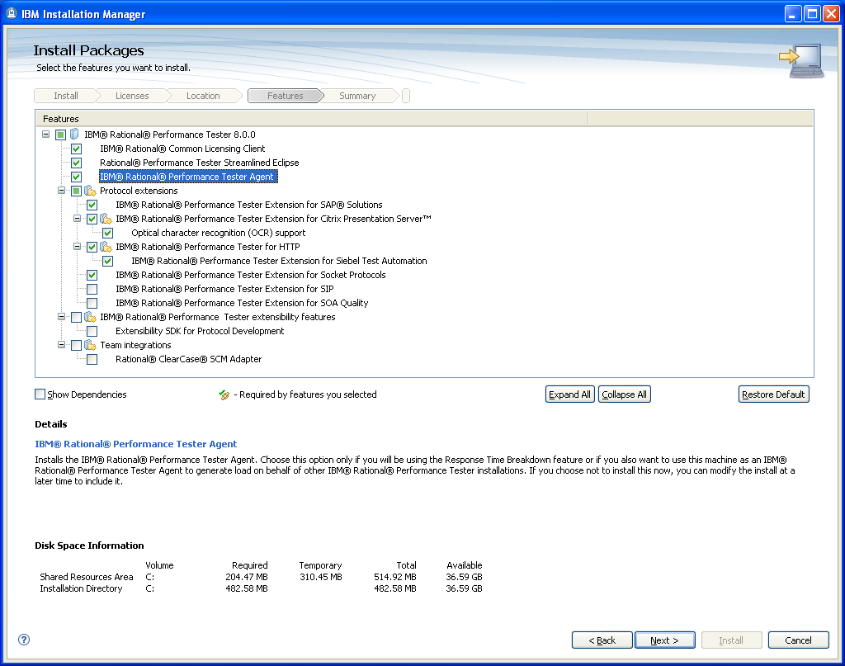
RPT Installation
Important!!

Slide 5
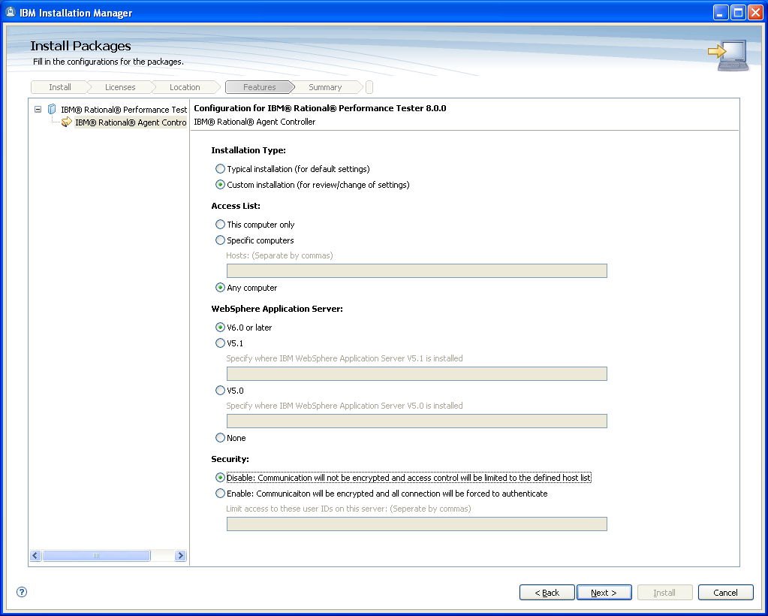
RPT Installation (Cont’d)

Slide 6
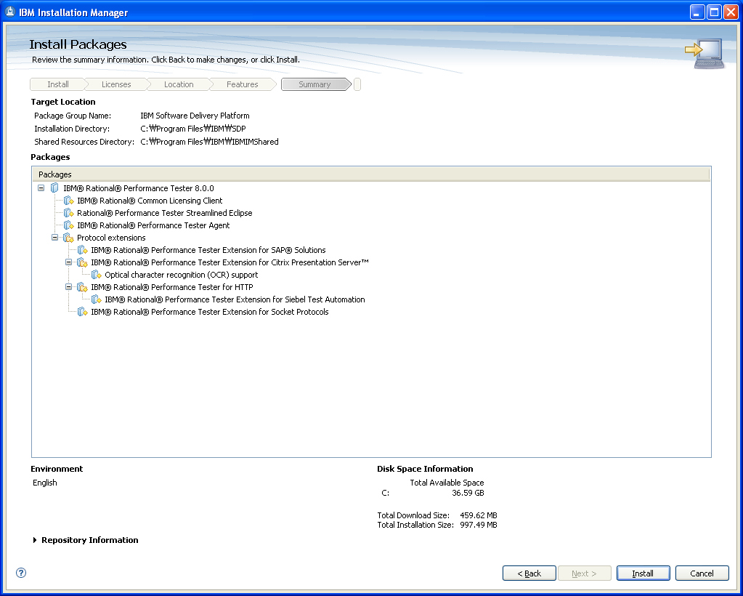
RPT Installation (Cont’d)

Slide 7
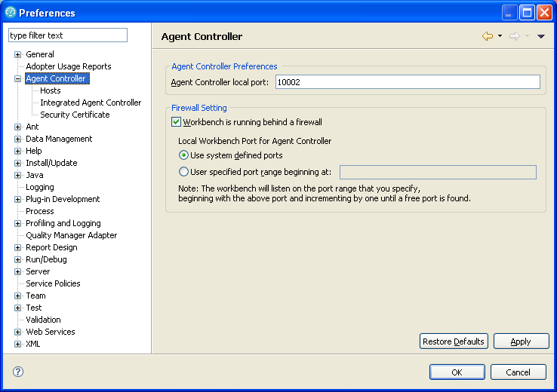
RPT Configuration

Slide 8
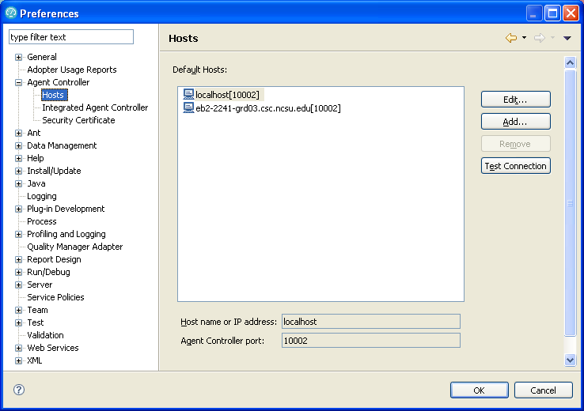
RPT Configuration (Cont’d)

Slide 9
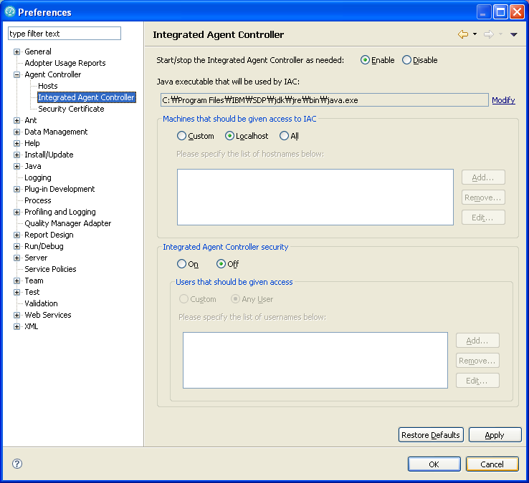
RPT Configuration (Cont’d)

Slide 10
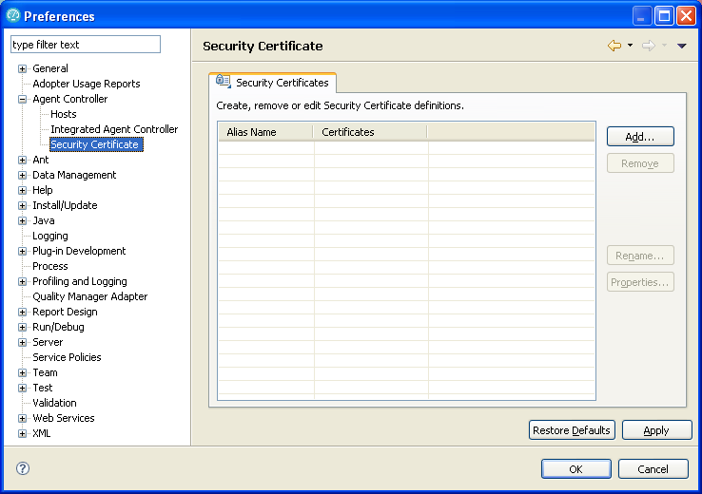
RPT Configuration (Cont’d)

Slide 11
Trouble Shooting

